Slide 1
Zomato Bangalore Restaurants
EDA & Data Visualization
CHANDRU M D

Slide 2
About Dataset
Online order – whether online ordering facility in the restaurants or Not
Book table – whether table booking facility in the restaurants or Not
Rate – contains the overall rating of the restaurants out of 5
Votes – contains total number of rating for the restaurants as of the mentioned date
Location – contains the neighbourhood in which the restaurants is located
Rest type – restaurant type like casual dining, café, quick bites, night clubs

Slide 3

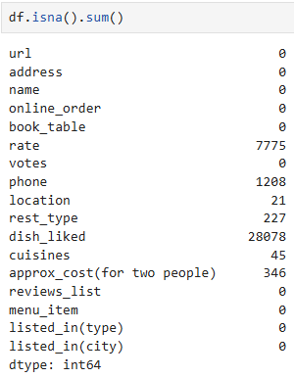
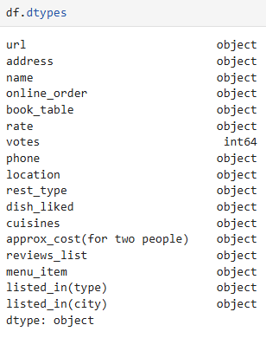
Gathering Data
Shape – 51717 Observations and 17 Features
Null values – rate, location, rest type, cuisines,
approx cost, these columns have some null values
Dtypes – Objects

Slide 4
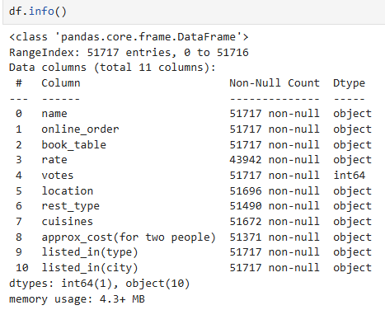
Info – it will give concise summary of data frame

Slide 5
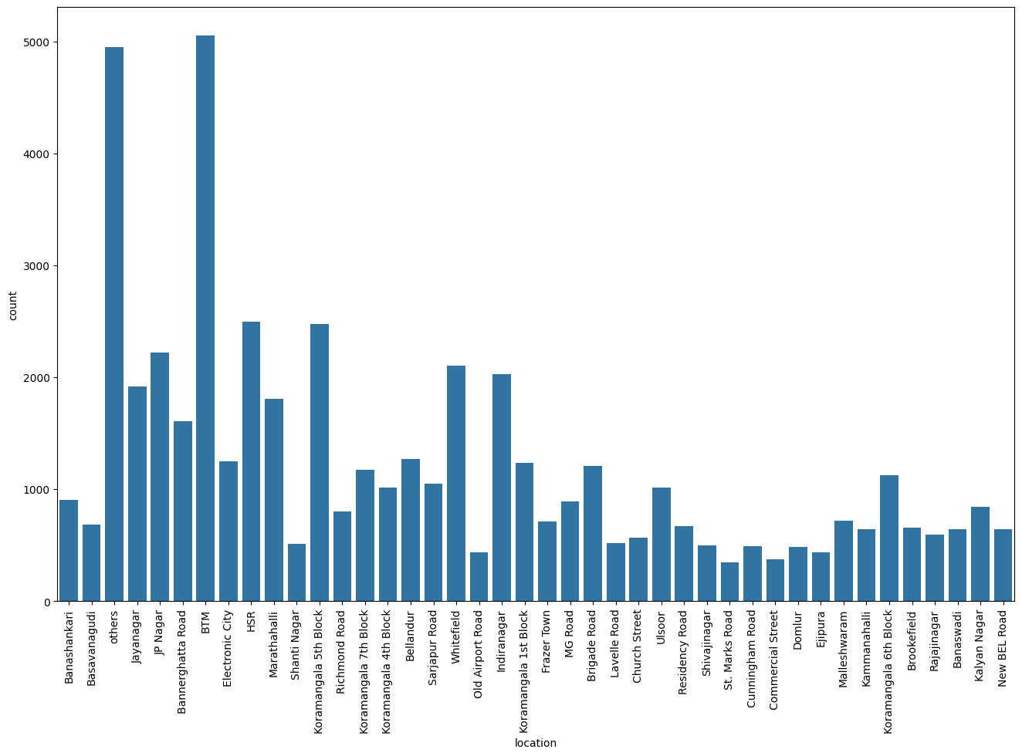
Visualizing various location in Bangalore using count plot

Slide 6
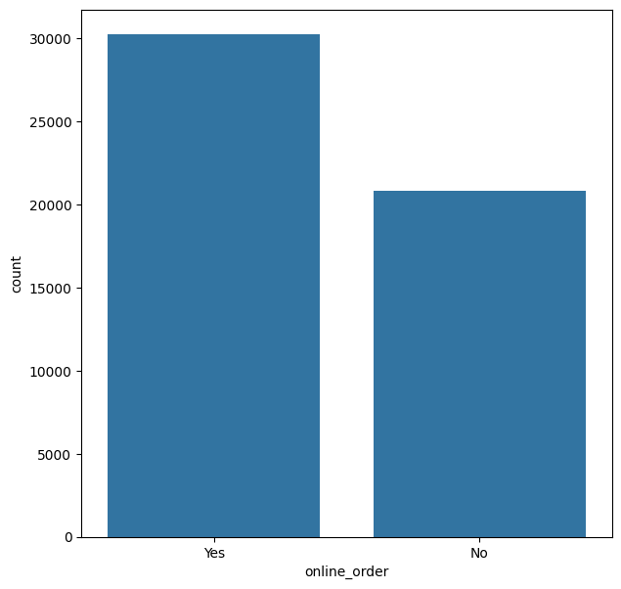
Visualizing the Online order using count plot

Slide 7
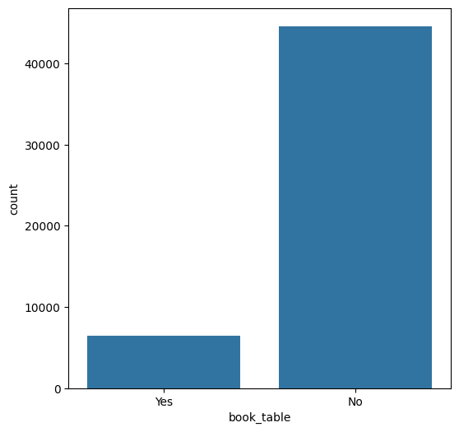
Visualizing the booking table in restaurant using count plot

Slide 8
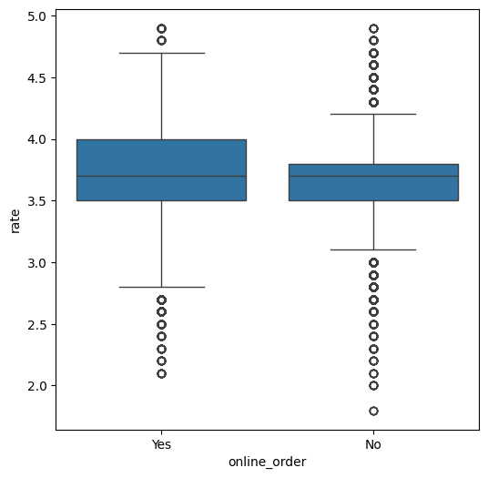
Visualizing Online order with respect to rate using boxplot

Slide 9
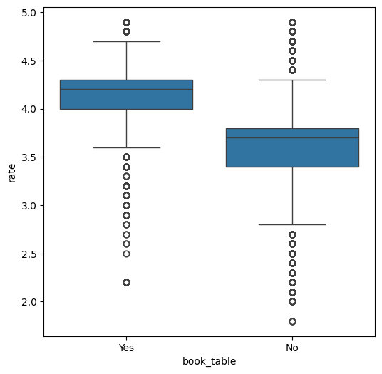
Visualizing booking table with respect to rate using boxplot

Slide 10
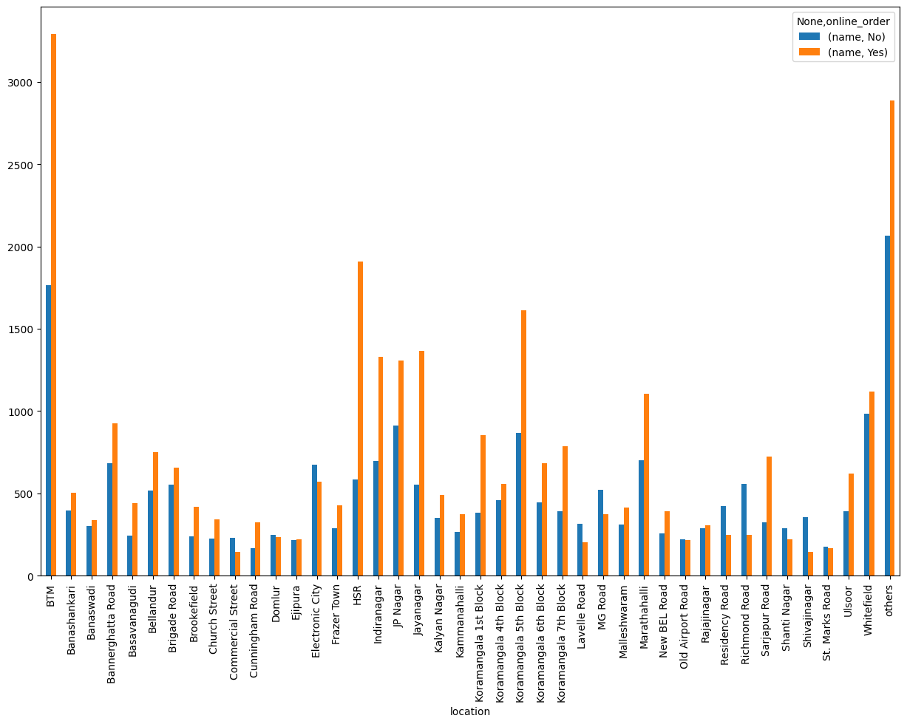
Visualizing the online order facility with respect to locations

Slide 11
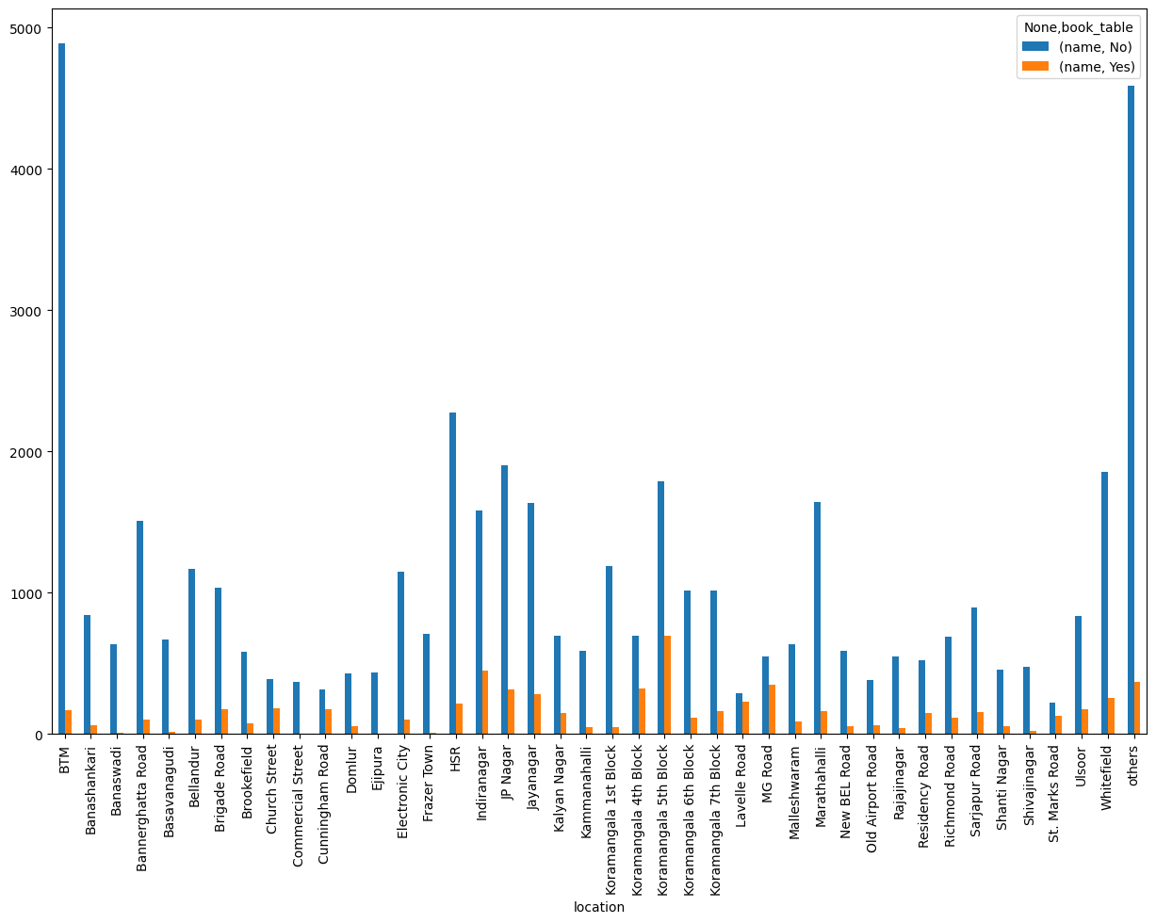
Visualizing booking table facility with respect to locations

Slide 12
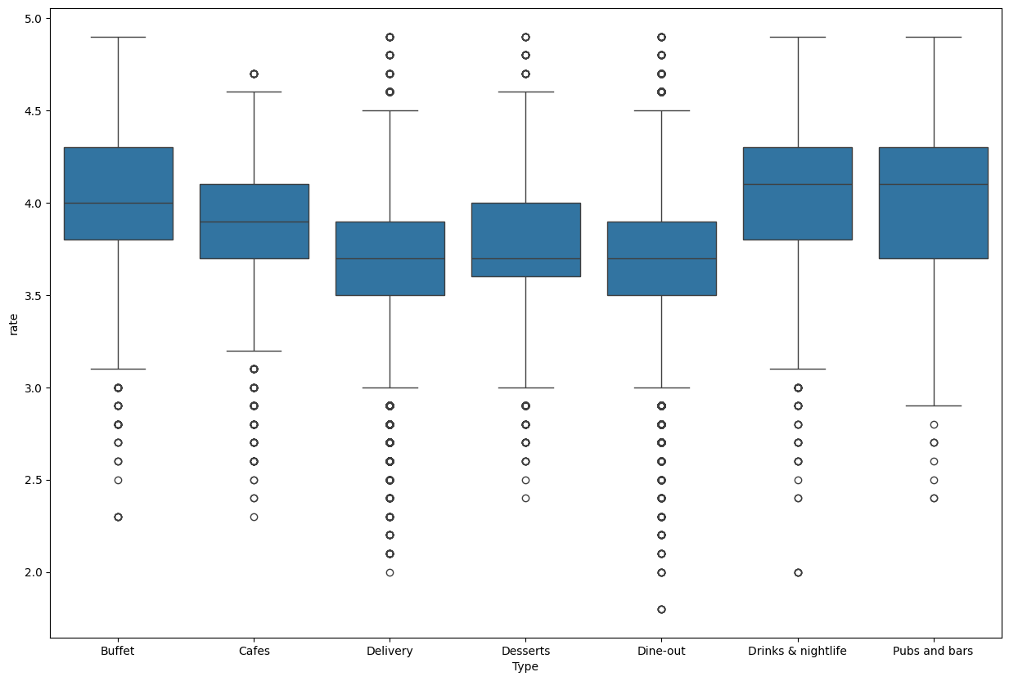
Visualizing types of Restuarants & Rate

Slide 13
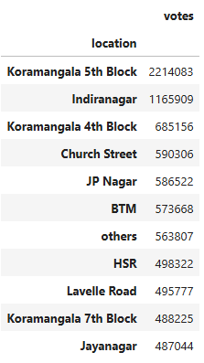
Groupby locations with respect to Votes(Top 10 locations)

Slide 14
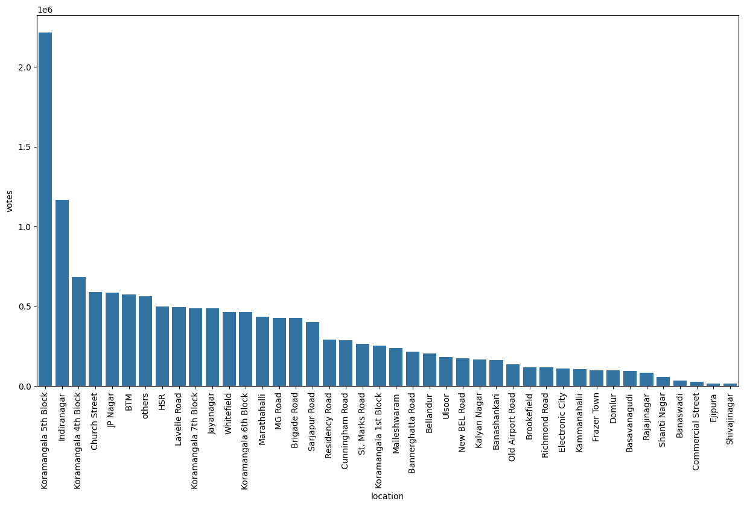
Visualizing votes with respected locations

Slide 15
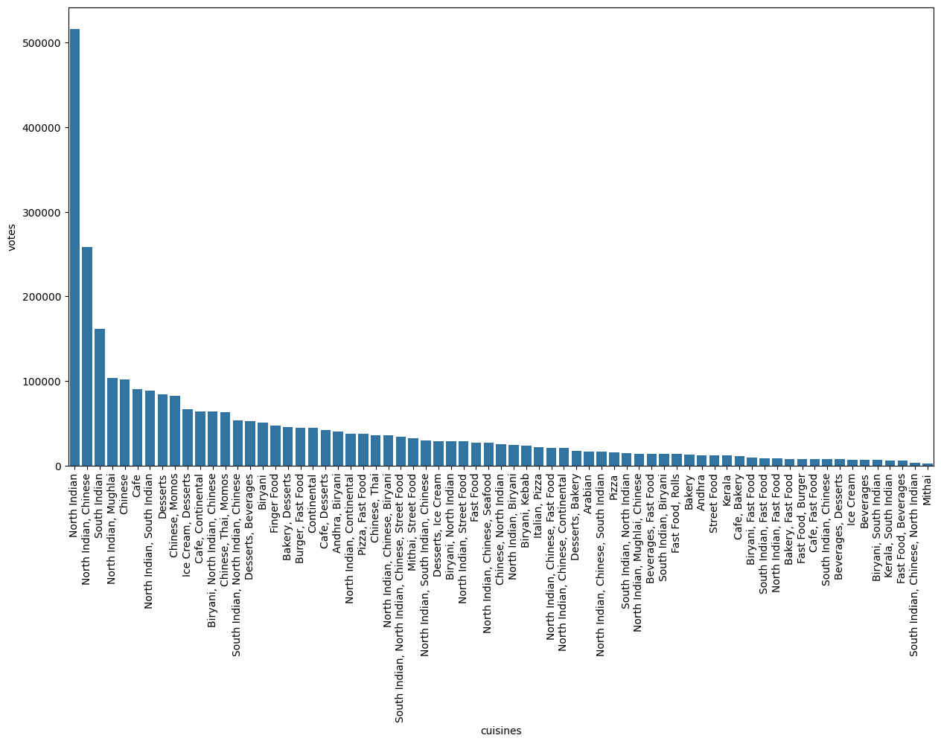
Visualizing cuisines with respect to votes

Slide 16
Thank you

